Slide 1

Echo Chambers & Cognitive Bias: Measuring Reactions on Reddit
Stanley Ou, Andy Ouyang, Julieta Ruiz, Gideon Deasy

Slide 2
Opening Question

Slide 3
Research Questions
1.1 A
How do people in a community of like-minded individuals react to polarizing information that goes against and for their beliefs?
How does this differ when the post is presented in a community of people who share an identity targeted by the post versus a more general community (i.e sports team vs sports in general)?
Notes:
30s

Slide 4
Class Connection
1.1 C
In class we discussed the various cognitive biases that impact how preferences are constructed and how decisions are made.
Echo chambers and connections to priors
Problem of the troll in information cascades
Notes:
30s

Slide 5
Data Used ~ Reddit
1.1 B
Reddit
Education
Sports
r/CMU
r/ApplyingtoCollege
r/Warriors
r/NBA
Notes:
1 min

Slide 6
Methods

Slide 7
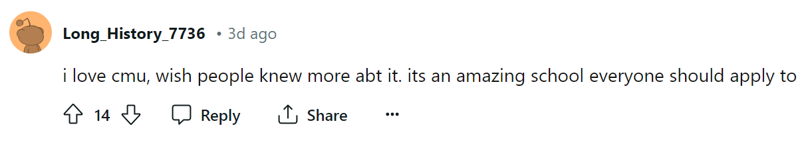
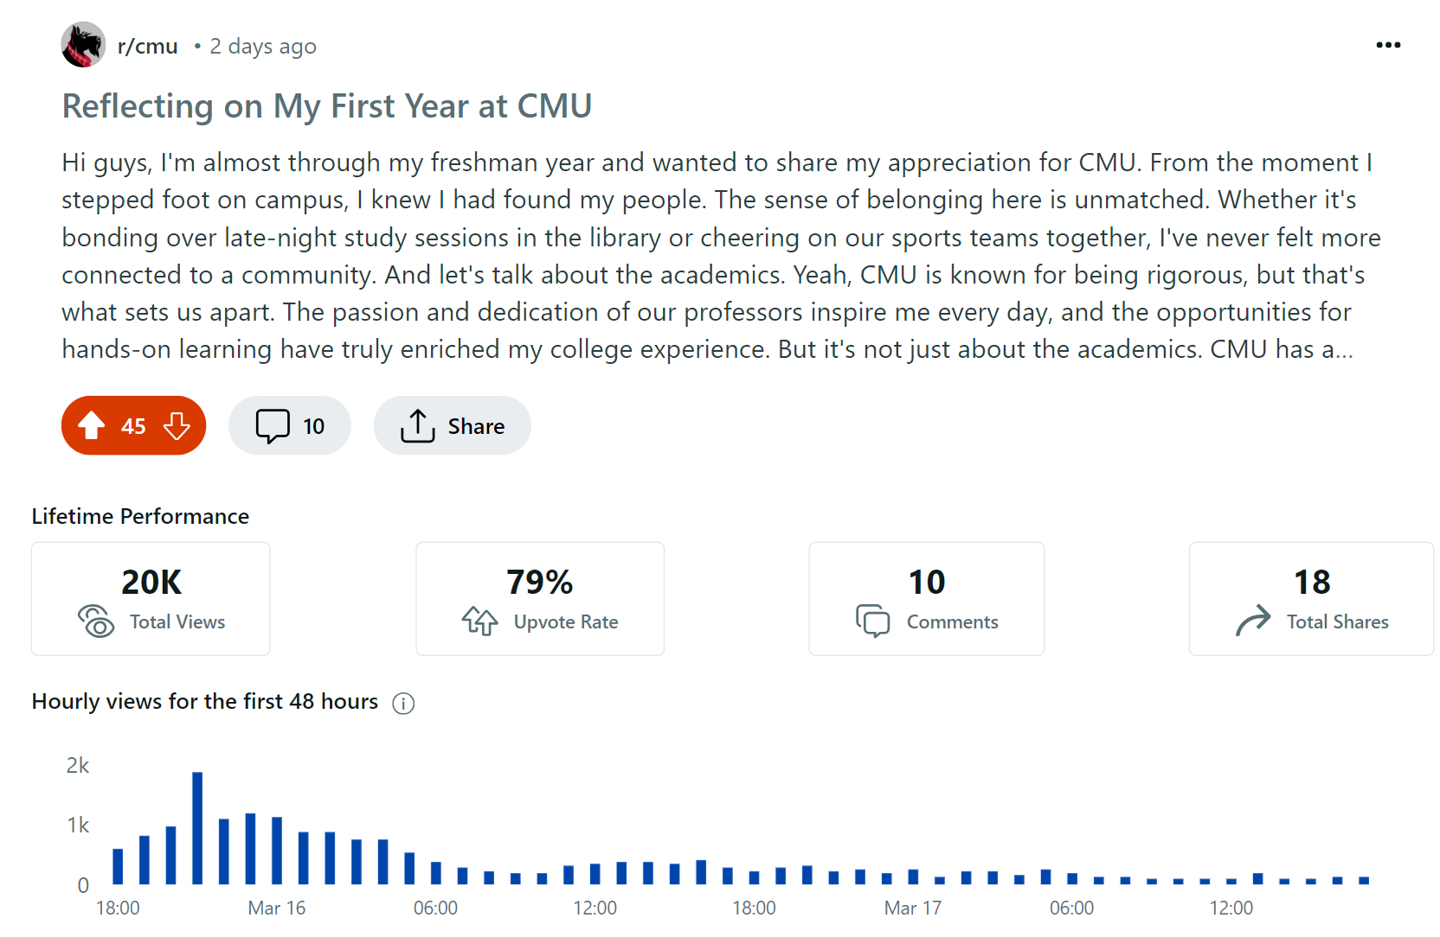
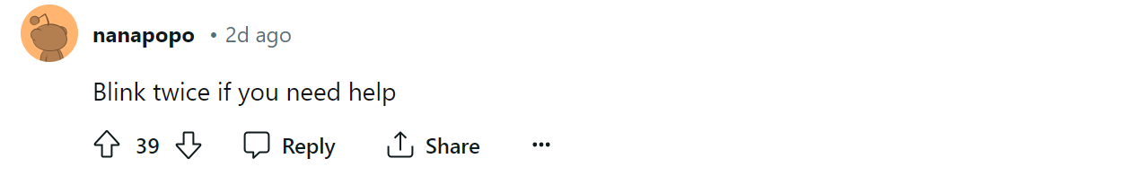


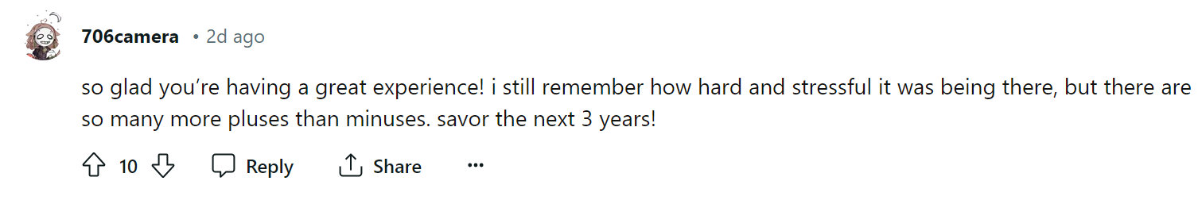
Example of Posts (+)
1.2 A
Notes:
45s

Slide 8
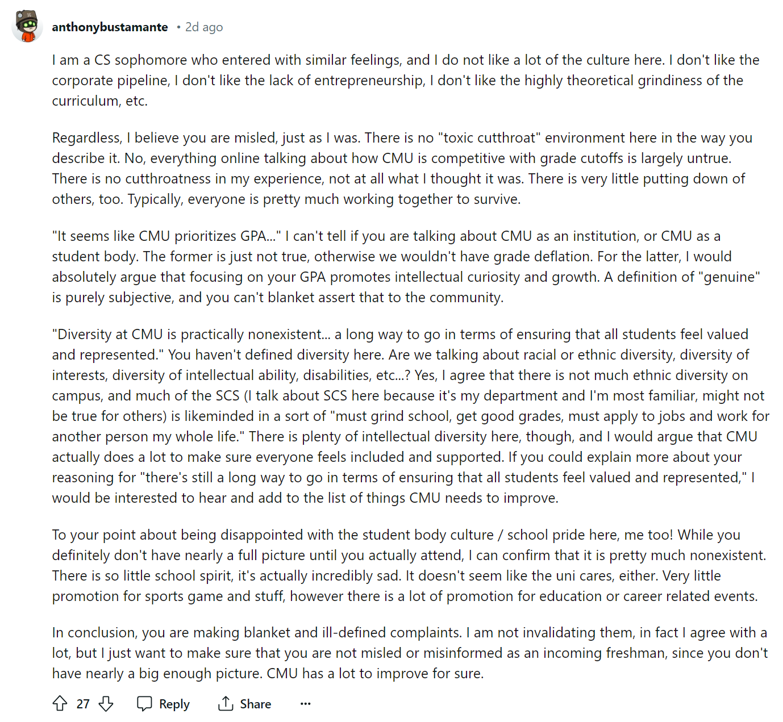

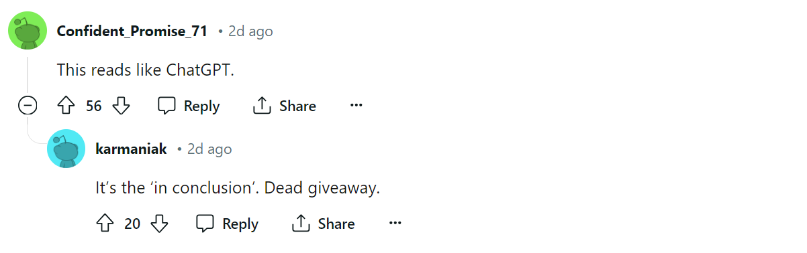
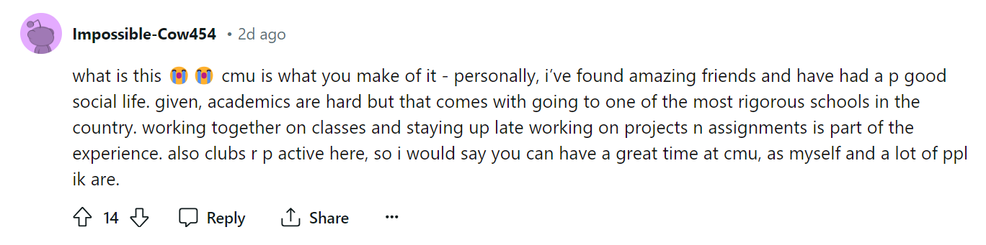
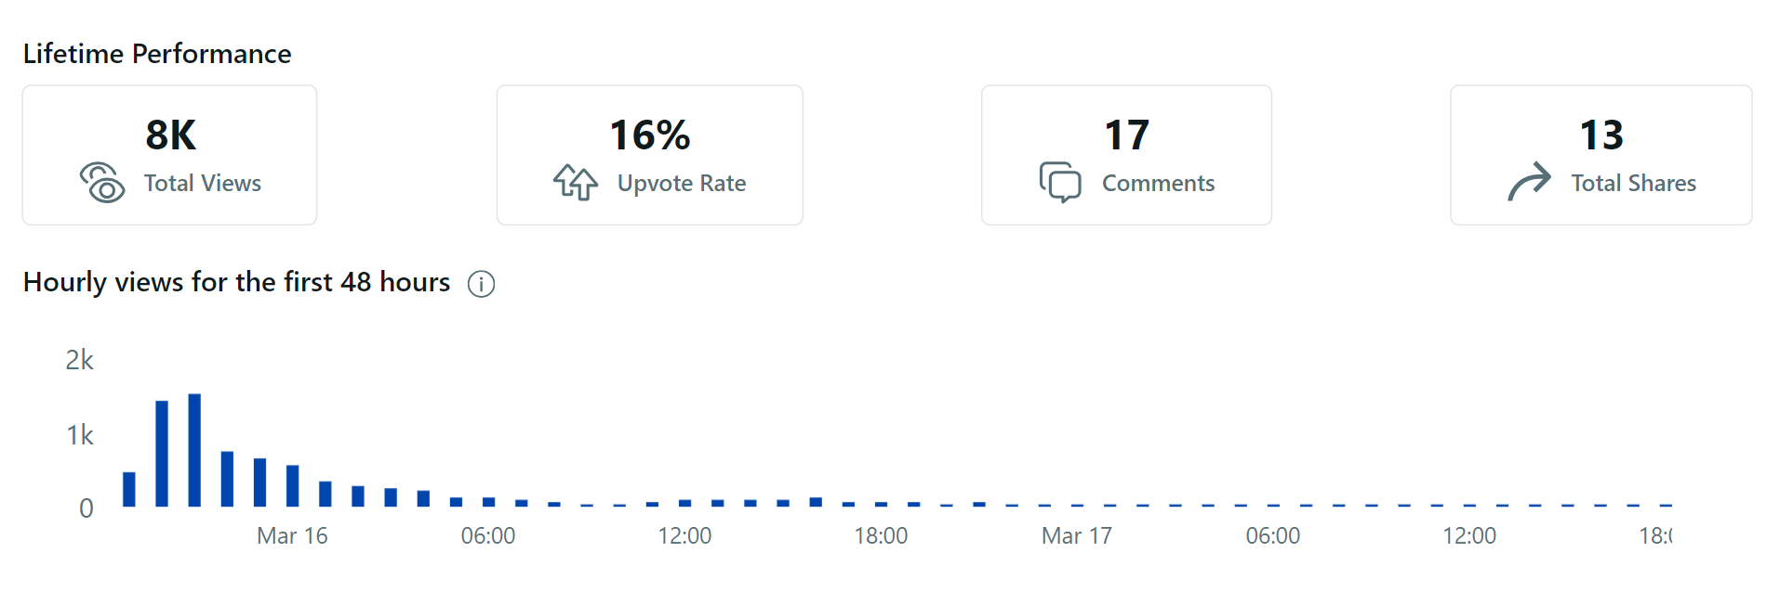
Example of Posts (-)
1.2 A
Notes:
45s

Slide 9
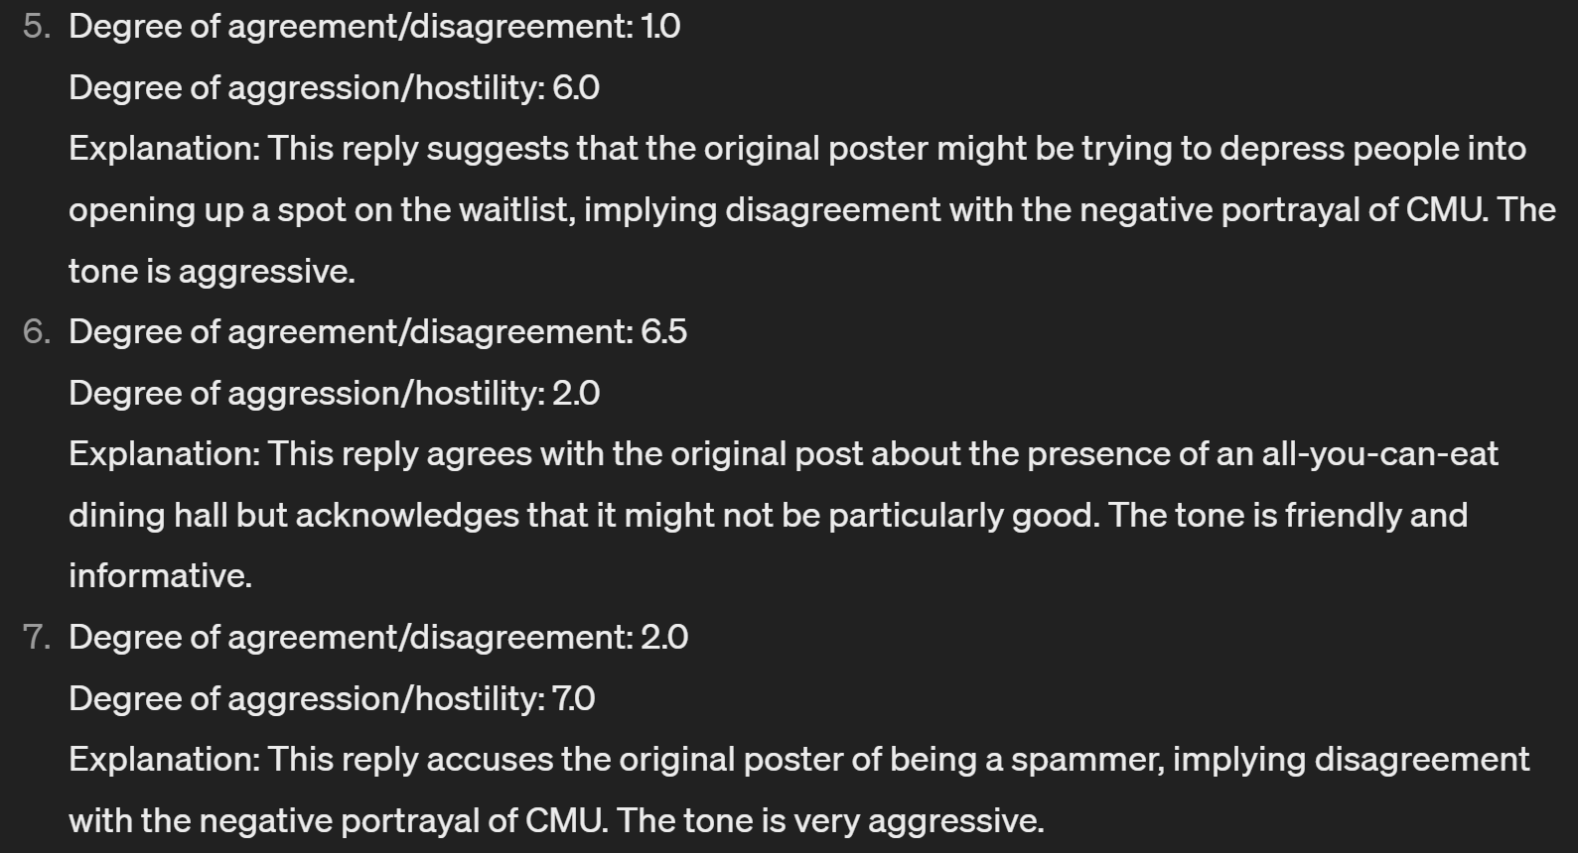
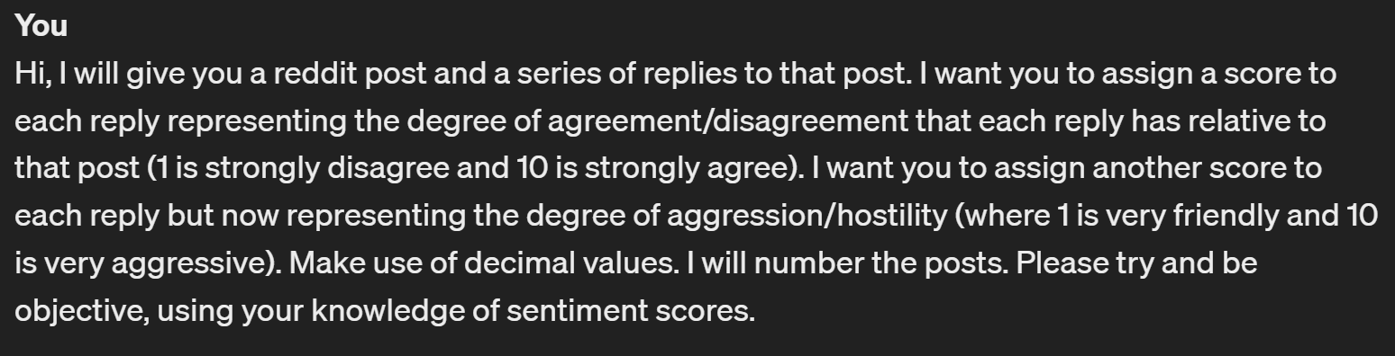
ChatGPT Analysis
1.2 A
Notes:
45s

Slide 10
Education

Slide 11
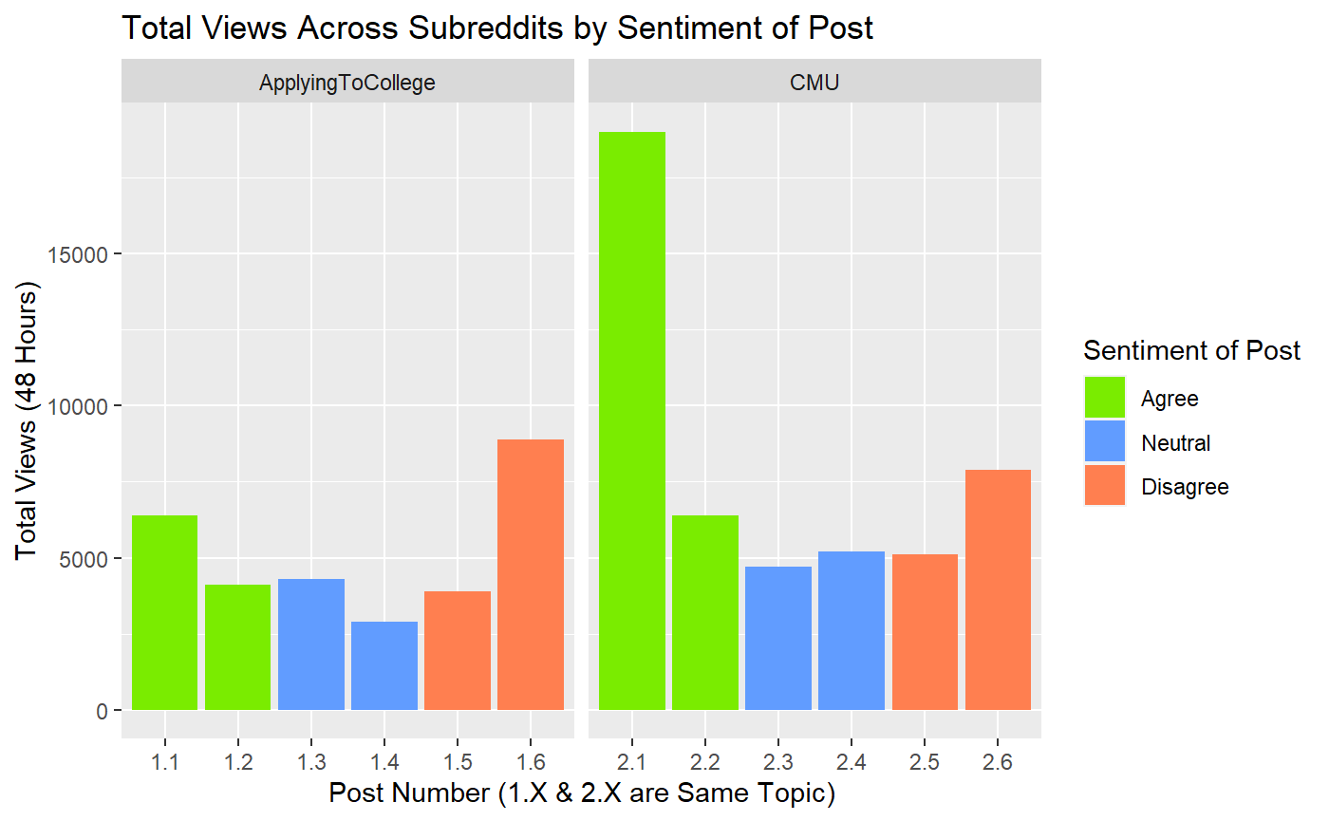
1.2 B

Slide 12
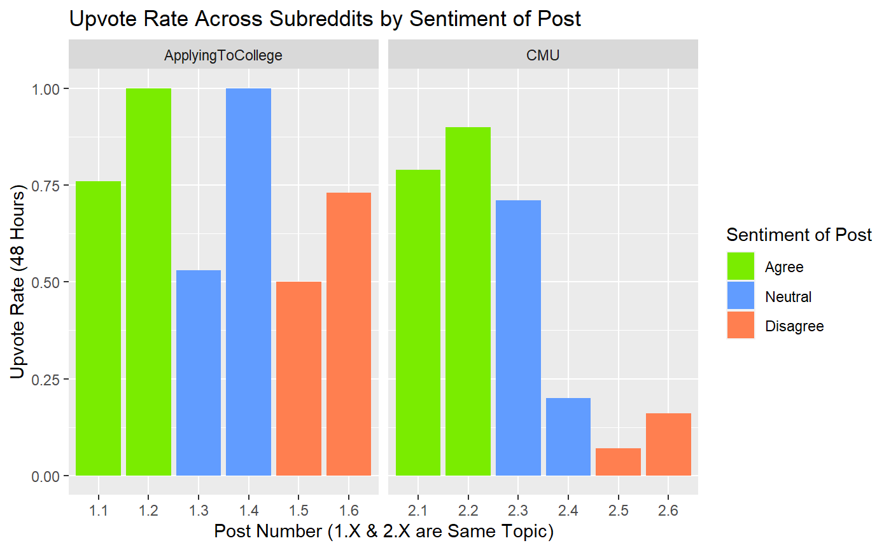
1.2 B

Slide 13
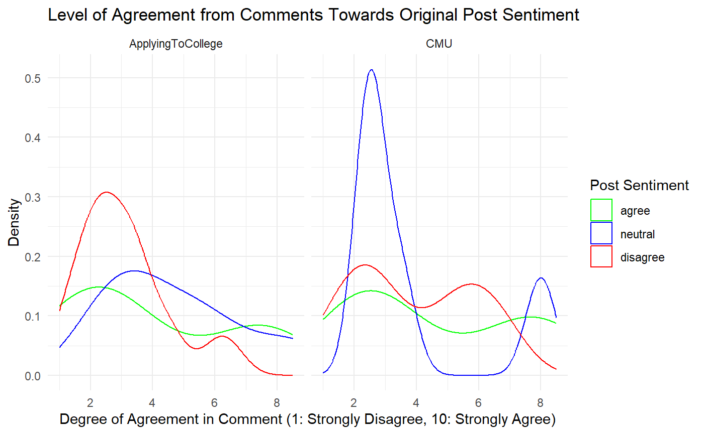
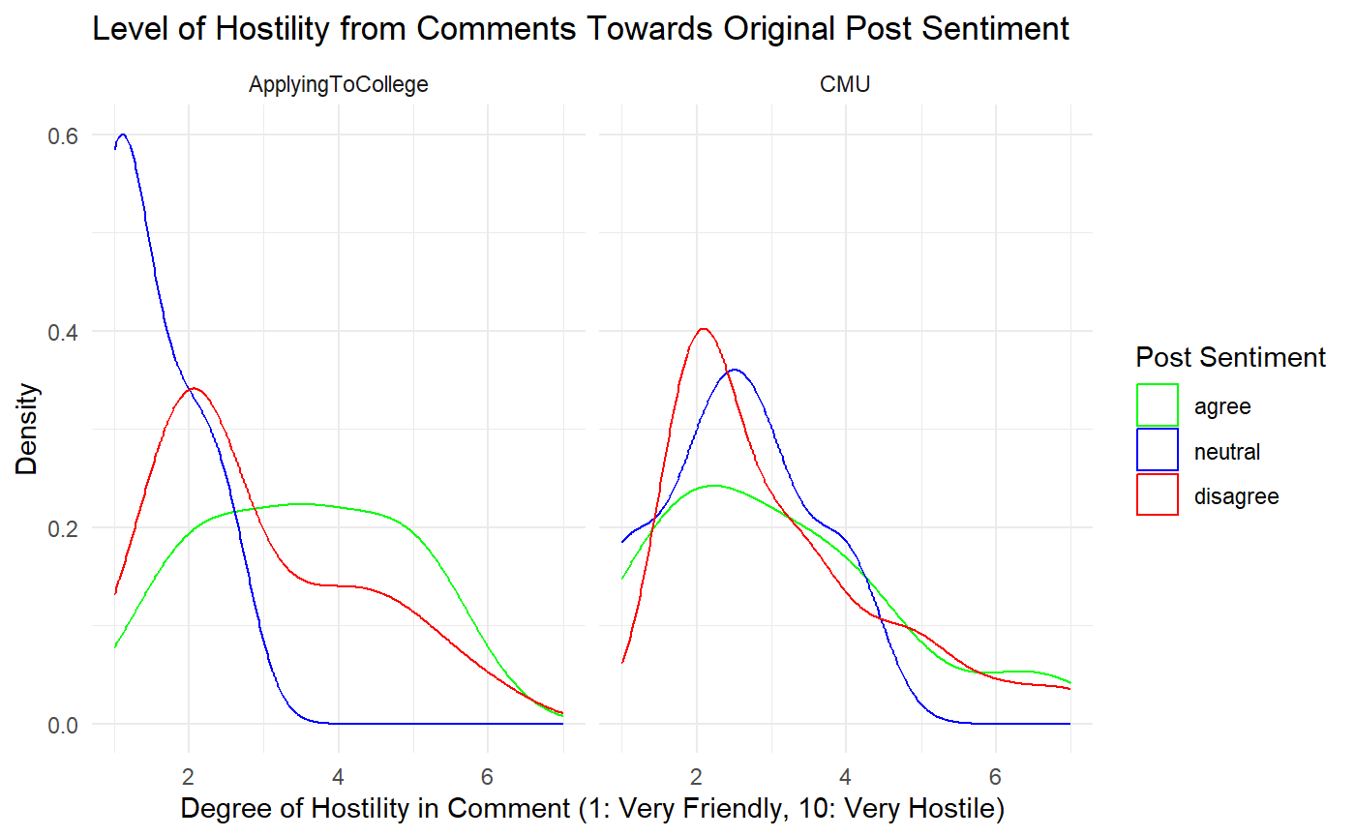
1.2 B

Slide 14
Sports

Slide 15
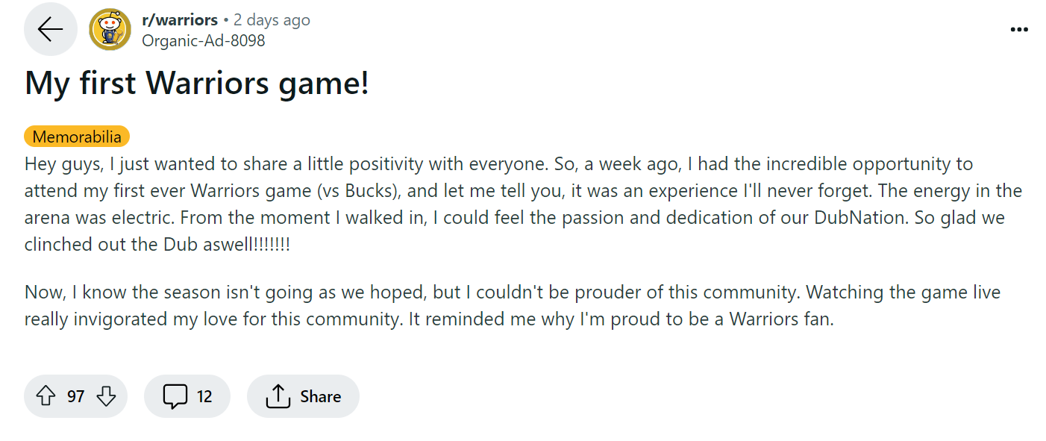
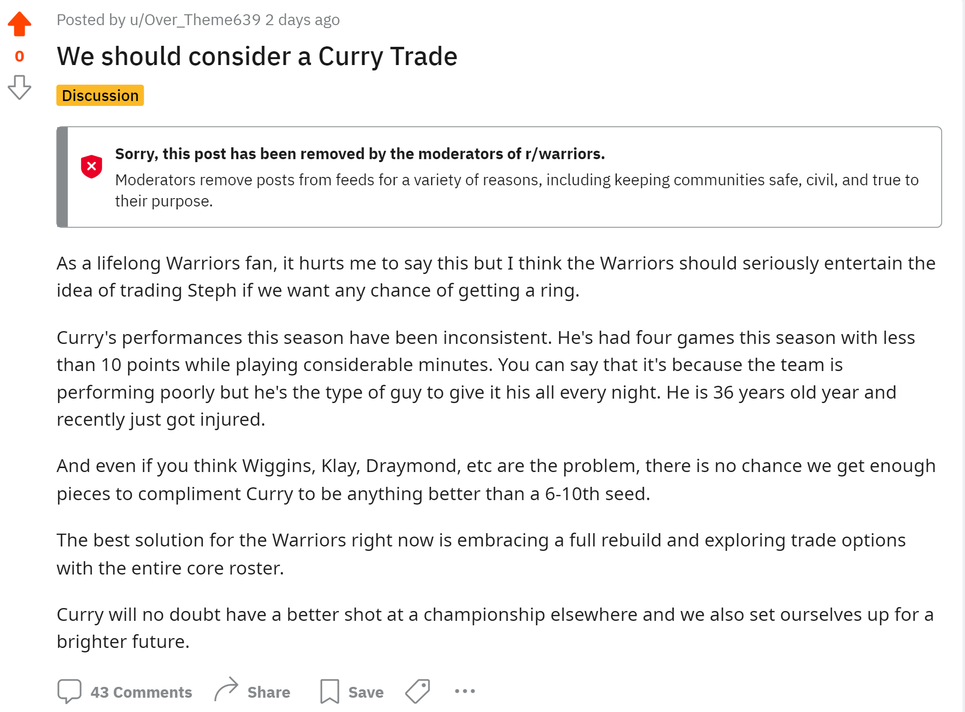
r/Warriors
1.2 A

Slide 16
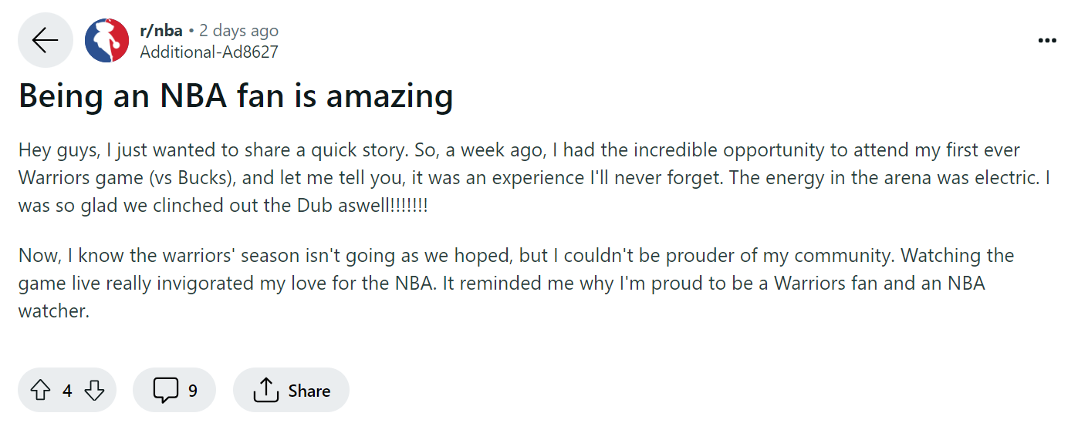
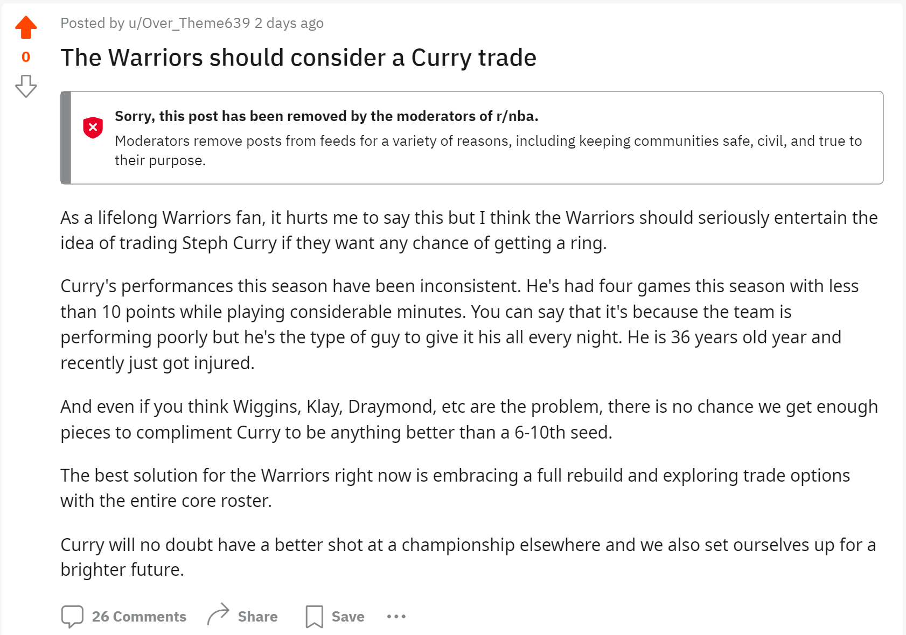
r/NBA
1.2 A

Slide 17
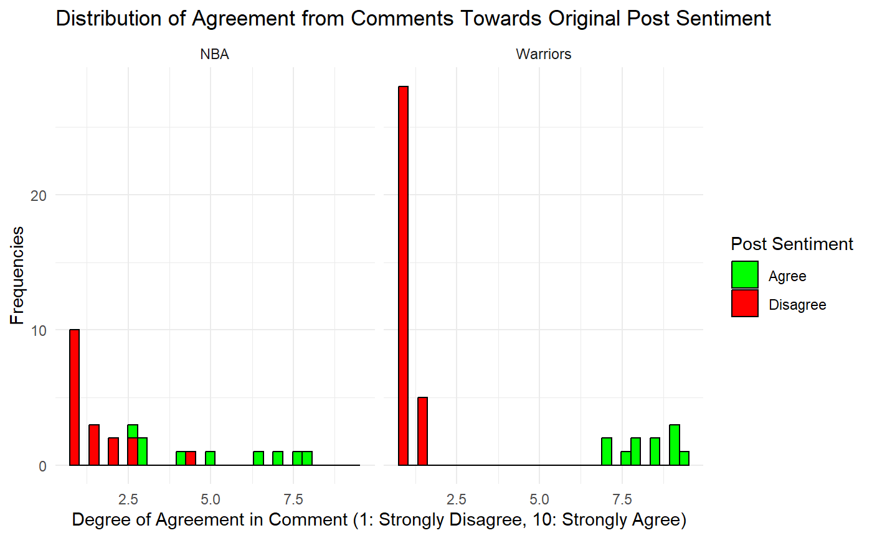
1.2 B

Slide 18
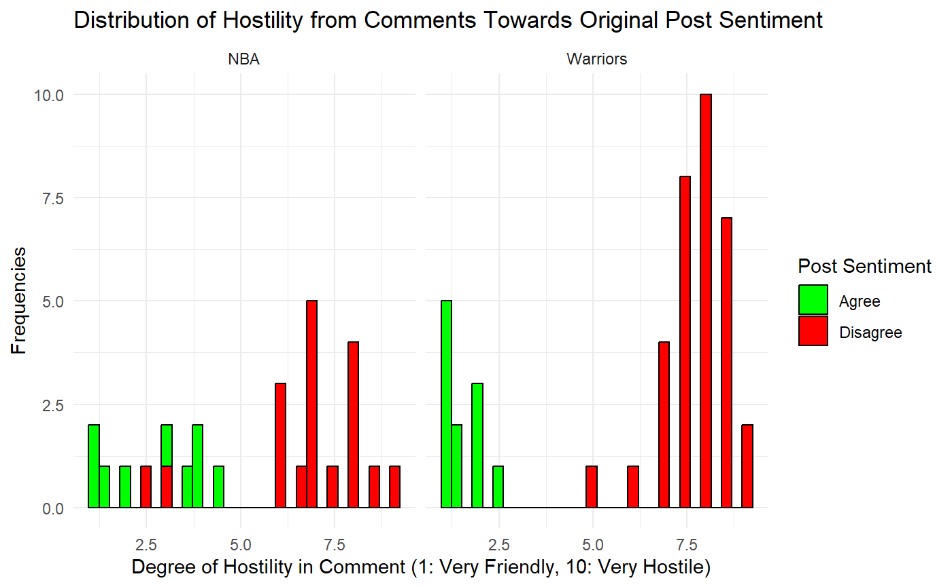
1.2 B

Slide 19
Results

Slide 20
Conclusions
1.3 A
As expected, disagreement posts garner negativity and agreement posts garner positivity. Neutral is mixed.
Reactions much more polarized in “identity” subreddits as opposed to more general subreddits
Posts that are in agreement or disagreement have higher engagement than neutral posts
Among all the pooled disagreement posts, there were far more accusations of the post being written by generative AI as opposed to agreement posts
Notes:
1

Slide 21
Limitations & Future Research
1.3 C
Directly copying posts from ChatGPT was not effective as their style of writing is too easily recognizable even though we tell it to write like a redditor
Auto-moderation in subreddits prevented posting.
Small sample size
ChatGPT sentiment analysis inaccurate => use pre-built model trained for sentiment analysis?
Difficult to objectively make agree/neutral/disagree posts
Other topics & other forums - more trial and error required
Notes:
1

Slide 22
The Meaning Behind Result
1.3 C
Understanding Human Behavior: We gained a deeper understanding of how information is processed within echo chambers and how people will seek and discuss information that aligns with their priors.
Impact of Technology on Communication: How anonymity and discourse contribute to online conversations involving different opinions.
Ethical Considerations with Echo Chambers: Echo chambers contribute to the polarization of society by preventing individuals from exploring diverse perspectives.
Notes:
1

Slide 23
Thank you!
Questions?

Slide 24
Link to Spreadsheet w/ Posts
https://docs.google.com/spreadsheets/d/1O2kRFJOBoZ2V4vQy3lA9Sbo_2tOQdkJ8FXhjg5C5Wn0/edit?usp=sharing

